Slide 1

Word Embeddings
- -

Slide 2
Word embeddings
Text processing with current NNs requires encoding into vectors.
One-hot encoding:
N words encoded by length N vectors.
A word gets a vector with exactly one entry = 1, others 0.
Very space inefficient, no natural language structure.
Bag of words:
Collection of words (along with number of occurences).
No word order, no natural language structure.

Slide 3
One Hot Encoding
One-hot encoding is a way to represent words (or any categorical data) as binary vectors. In a one-hot vector:
Only one element is 1 (hot), indicating the presence of a word.
All other elements are 0 (cold).
The position of the 1 corresponds to the word’s index in the vocabulary.

Slide 4
One Hot Encoding Example
One-Hot Encoding Example
Vocabulary = ["cat", "dog", "apple", "car", "banana"]
(Each word gets a unique index.)
Word | One-Hot Vector
cat | [1, 0, 0, 0, 0]
dog | [0, 1, 0, 0, 0]
apple | [0, 0, 1, 0, 0]
car | [0, 0, 0, 1, 0]
banana | [0, 0, 0, 0, 1]
Word | cat | dog | apple | car | banana
cat | 1 | 0 | 0 | 0 | 0
dog | 0 | 1 | 0 | 0 | 0
apple | 0 | 0 | 1 | 0 | 0
car | 0 | 0 | 0 | 1 | 0
banana | 0 | 0 | 0 | 0 | 1

Slide 5
One Hot Encoding Limitations
Limitations of One-Hot
No meaning is captured (e.g., "cat" and "dog" aren't close).
Vectors are sparse and high-dimensional.
Vocabulary size determines the vector size — gets huge with large corpora.

Slide 6
Motivation: Why Word embeddings?
Content:
Traditional approaches (e.g., one-hot encoding) are limited:
Large and sparse vectors
No notion of semantic similarity
Need for dense, meaningful representations
Explanation: Explain that in early NLP, words were represented using one-hot encoding: each word gets a unique binary vector. This results in sparse vectors and doesn’t capture relationships like "king" is related to "queen" or "Paris" to "France". Word embeddings solve this.

Slide 7
What is Word embeddings: idea
Idea: learn an embedding from words into vectors
Word embeddings are dense, low-dimensional vectors
Words with similar meanings have similar vectors
Learn embeddings from large corpora
Example:
king → [0.21, 0.57, -0.33, ...]
queen → [0.19, 0.55, -0.30, ...]
Explanation: Embeddings place words in a continuous vector space where semantic relationships are preserved. You can illustrate this with a scatter plot of embeddings showing clusters of related terms (e.g., countries, cities, emotions).
http://colah.github.io/posts/2014-07-NLP-RNNs-Representations/

Slide 8
What is Word embeddings: idea
Note: Numbers are illustrative—not learned—so you can see how embeddings encode meaning.
Example:
Feature / Word | Cat | dog | apple | car | banana
Animal | 0.95 | 0.96 | 0.00 | 0.00 | 0.00
Pet | 0.90 | 0.92 | 0.00 | 0.00 | 0.00
Fruit | 0.00 | 0.00 | 0.98 | 0.00 | 0.97
Vehicle | 0.00 | 0.00 | 0.00 | 0.99 | 0.00
Edible / Food | 0.00 | 0.00 | 0.88 | 0.00 | 0.89
Word Vectors (5D)
cat → [0.95, 0.90, 0.00, 0.00, 0.00]
dog → [0.96, 0.92, 0.00, 0.00, 0.00]
apple → [0.00, 0.00, 0.98, 0.00, 0.88]
car → [0.00, 0.00, 0.00, 0.99, 0.00]
banana → [0.00, 0.00, 0.97, 0.00, 0.89]
Each word is a point in 5D space.
cat and dog are close together (similar embeddings).
apple and banana are close (both fruits).
car is far apart (unique vehicle feature).
http://colah.github.io/posts/2014-07-NLP-RNNs-Representations/

Slide 9
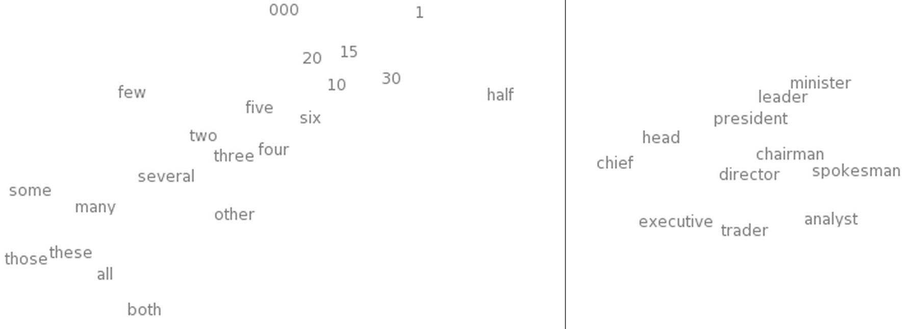
Word embeddings: similarity
Hope to have similar words nearby
http://colah.github.io/posts/2014-07-NLP-RNNs-Representations/

Slide 10
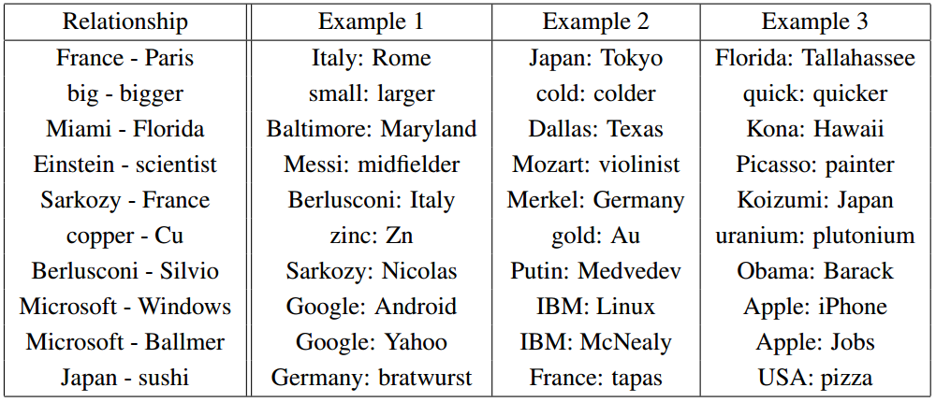
Word embeddings: relationships
Hope to preserve some language structure (relationships between words).
http://colah.github.io/posts/2014-07-NLP-RNNs-Representations/

Slide 11
Pretrained Embeddings Overview
Key Types of Word Embeddings
Pretrained embeddings (ready to use)
Custom-trained embeddings (trained on your own text)
Model | Contextual? | Dimensions | Trained On
Word2Vec | ❌ No | 100–300 | Google News
GloVe | ❌ No | 50–300 | Wikipedia, Common Crawl
FastText | ❌ No | 300 | Wikipedia, Web data
ELMo | ✅ Yes | 1024 | 1 Billion Word Corpus
BERT | ✅ Yes | 768+ | Books, Wikipedia
RoBERTa | ✅ Yes | 1024 | Books, CC-News, etc.
http://colah.github.io/posts/2014-07-NLP-RNNs-Representations/

Slide 12
Word embeddings: properties
Need to have a function W(word) that returns a vector encoding that word.
Similarity of words corresponds to nearby vectors.
Director – chairman, scratched – scraped
Relationships between words correspond to difference between vectors.
Big – bigger, small – smaller

Slide 13
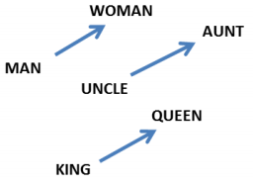

Word embeddings: properties
Relationships between words correspond to difference between vectors.
http://colah.github.io/posts/2014-07-NLP-RNNs-Representations/

Slide 14
Word embeddings: questions
How big should the embedding space be?
Trade-offs like any other machine learning problem – greater capacity versus efficiency and overfitting.
How do we find W?
Often as part of a prediction or classification task involving neighboring words.

Slide 15
Word embeddings (continued)
Idea: learn an embedding from words into vectors
Need to have a function W(word) that returns a vector encoding that word.
http://colah.github.io/posts/2014-07-NLP-RNNs-Representations/

Slide 16
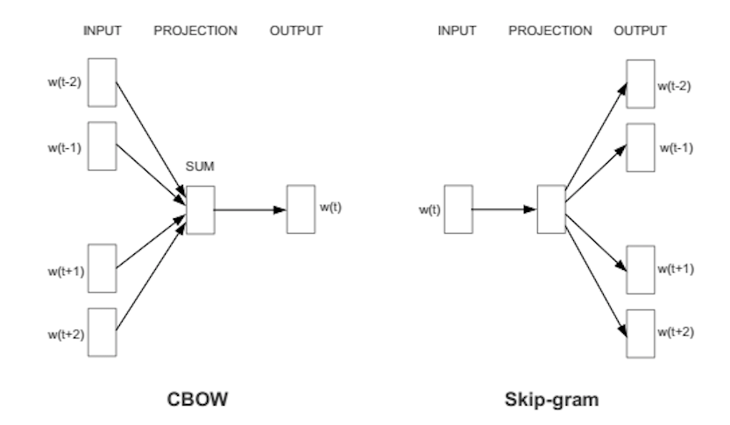
word2vec
Predict words using context
Two versions: CBOW (continuous bag of words) and Skip-gram
https://skymind.ai/wiki/word2vec

Slide 17
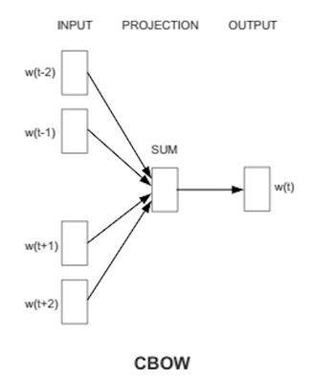
CBOW
Bag of words
Gets rid of word order. Used in discrete case using counts of words that appear.
CBOW
Takes vector embeddings of n words before target and n words after and adds them (as vectors).
Also removes word order, but the vector sum is meaningful enough to deduce missing word.

Slide 18
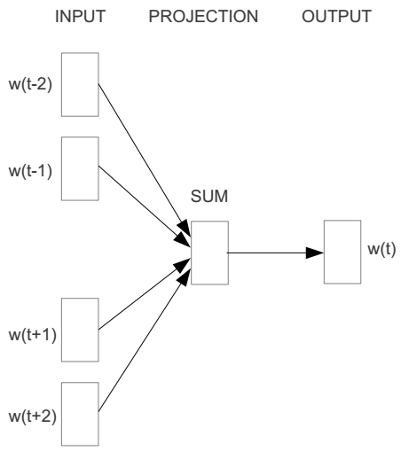
Word2vec – Continuous Bag of Word
E.g. “The cat sat on floor”
Window size = 2
the
cat
sat
on
floor
www.cs.ucr.edu/~vagelis/classes/CS242/slides/word2vec.pptx

Slide 19
Word2vec – Continuous Bag of Word – Window Size = 1
Input layer
Index of cat in vocabulary
0
1
0
cat
0
Hidden layer
Output layer
0
0
0
0
0
0
…
0
0
0
one-hot
vector
0
sat
one-hot
vector
0
0
0
0
1
0
…
1
0
on
0
0
0
0
…
0
www.cs.ucr.edu/~vagelis/classes/CS242/slides/word2vec.pptx

Slide 20



We must learn W and W’
Input layer
0
1
0
cat
0
$$W_{V×N}$$
Hidden layer
Output layer
0
0
0
0
0
0
V-dim
…
0
0
$${W′}_{N×V}$$
0
0
sat
0
0
0
0
1
0
$$W_{V×N}$$
N-dim
…
V-dim
1
0
on
0
0
0
0
V-dim
…
N will be the size of word vector
0
www.cs.ucr.edu/~vagelis/classes/CS242/slides/word2vec.pptx

Slide 21
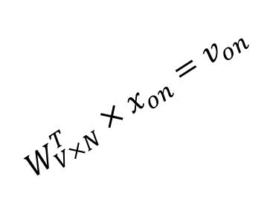

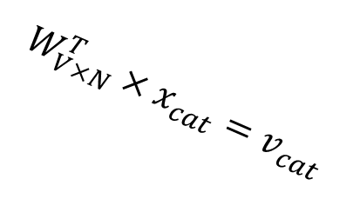



$$W_{V×N}^{T} ×x_{cat}=v_{cat}$$
0.1 | 2.4 | 1.6 | 1.8 | 0.5 | 0.9 | … | … | … | 3.2
0.5 | 2.6 | 1.4 | 2.9 | 1.5 | 3.6 | … | … | … | 6.1
… | … | … | … | … | … | … | … | … | …
… | … | … | … | … | … | … | … | … | …
0.6 | 1.8 | 2.7 | 1.9 | 2.4 | 2.0 | … | … | … | 1.2
0
2.4
2.6
…
…
1.8
Input layer
1
$$×$$
0
$$=$$
0
0
1
0
0
0
x_{cat}
0
0
Output layer
0
0
0
$$W_{V×N}^{T}×x_{cat}=v_{cat}$$
…
0
0
0
0
0
V-dim
…
0
0
$$\hat{v}=\frac{v_{cat}+v_{on}}{2}$$
0
+
0
sat
0
0
0
0
$$W_{V×N}^{T}×x_{on}=v_{on}$$
1
0
…
V-dim
1
Hidden layer
0
x_{on}
0
0
N-dim
0
0
V-dim
…
0
www.cs.ucr.edu/~vagelis/classes/CS242/slides/word2vec.pptx

Slide 22

$$W_{V×N}^{T} ×x_{on}=v_{on}$$
0.1 | 2.4 | 1.6 | 1.8 | 0.5 | 0.9 | … | … | … | 3.2
0.5 | 2.6 | 1.4 | 2.9 | 1.5 | 3.6 | … | … | … | 6.1
… | … | … | … | … | … | … | … | … | …
… | … | … | … | … | … | … | … | … | …
0.6 | 1.8 | 2.7 | 1.9 | 2.4 | 2.0 | … | … | … | 1.2
0
1.8
2.9
…
…
1.9
Input layer
0
$$×$$
0
$$=$$
0
1
1
0
0
0
x_{cat}
0
0
Output layer
0
0
0
$$W_{V×N}^{T}×x_{cat}=v_{cat}$$
…
0
0
0
0
0
V-dim
…
0
0
$$\hat{v}=\frac{v_{cat}+v_{on}}{2}$$
0
+
0
sat
0
0
0
0
$$W_{V×N}^{T}×x_{on}=v_{on}$$
1
0
…
V-dim
1
Hidden layer
0
x_{on}
0
0
N-dim
0
0
V-dim
…
0
www.cs.ucr.edu/~vagelis/classes/CS242/slides/word2vec.pptx

Slide 23






Input layer
0
1
0
cat
0
$$W_{V×N}$$
Hidden layer
Output layer
0
0
0
0
0
0
V-dim
…
0
0
$$W_{V×N}^{′}×\hat{v}=z$$
0
$$\hat{y}=softmax(z)$$
0
0
0
0
0
$$\hat{v}$$
1
0
$$W_{V×N}$$
…
1
N-dim
0
on
0
${\hat{y}}_{sat}$
0
0
V-dim
0
V-dim
…
N will be the size of word vector
0
www.cs.ucr.edu/~vagelis/classes/CS242/slides/word2vec.pptx

Slide 24


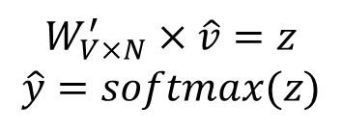
Input layer
0
We would prefer $\hat{y}$ close to ${\hat{y}}_{sat}$
1
0
cat
0
$$W_{V×N}$$
Hidden layer
Output layer
0
0
0
0
0.01
0.02
0.00
0.02
0.01
0.02
0.01
0.7
…
0.00
0
0
V-dim
…
0
0
$$W_{V×N}^{′}×\hat{v}=z$$
$$\hat{y}=softmax(z)$$
0
0
0
0
0
0
$$\hat{v}$$
1
0
$$W_{V×N}$$
…
1
N-dim
0
on
0
${\hat{y}}_{sat}$
0
0
V-dim
0
V-dim
…
N will be the size of word vector
$\hat{y}$
0
www.cs.ucr.edu/~vagelis/classes/CS242/slides/word2vec.pptx

Slide 25




$$W_{V×N}^{T}$$
0.1 | 2.4 | 1.6 | 1.8 | 0.5 | 0.9 | … | … | … | 3.2
0.5 | 2.6 | 1.4 | 2.9 | 1.5 | 3.6 | … | … | … | 6.1
… | … | … | … | … | … | … | … | … | …
… | … | … | … | … | … | … | … | … | …
0.6 | 1.8 | 2.7 | 1.9 | 2.4 | 2.0 | … | … | … | 1.2
Contain word’s vectors
Input layer
0
1
0
x_{cat}
0
Output layer
0
0
$$W_{V×N}^{}$$
0
0
0
0
V-dim
…
0
0
$$W_{V×N}^{′}$$
0
0
sat
0
0
0
0
1
0
$$W_{V×N}^{}$$
…
1
0
V-dim
x_{on}
0
Hidden layer
0
N-dim
0
0
V-dim
…
0
We can consider either W or W’ as the word’s representation. Or even take the average.
www.cs.ucr.edu/~vagelis/classes/CS242/slides/word2vec.pptx
Notes:
W contains input word vectors.
W’ contains output word vectors.
We can consider either W or W’ as the word’s representation. Or even take the average.

Slide 26
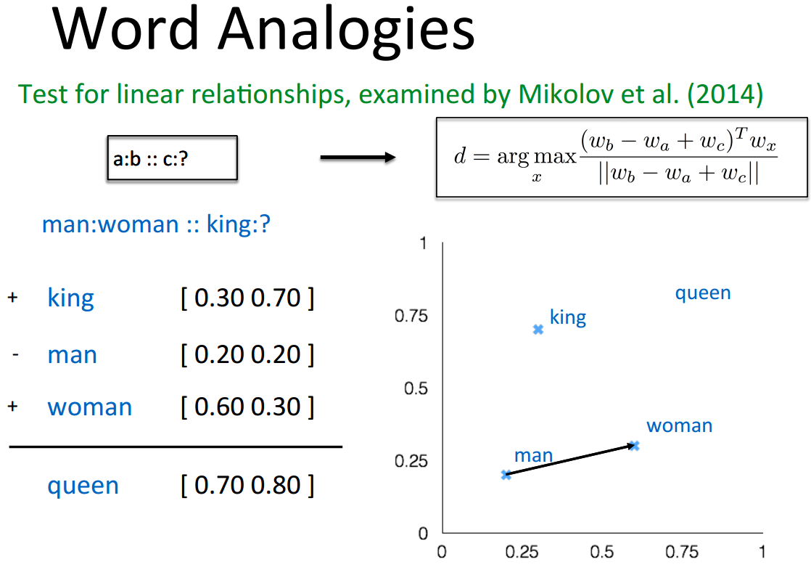
Some interesting results
www.cs.ucr.edu/~vagelis/classes/CS242/slides/word2vec.pptx

Slide 27
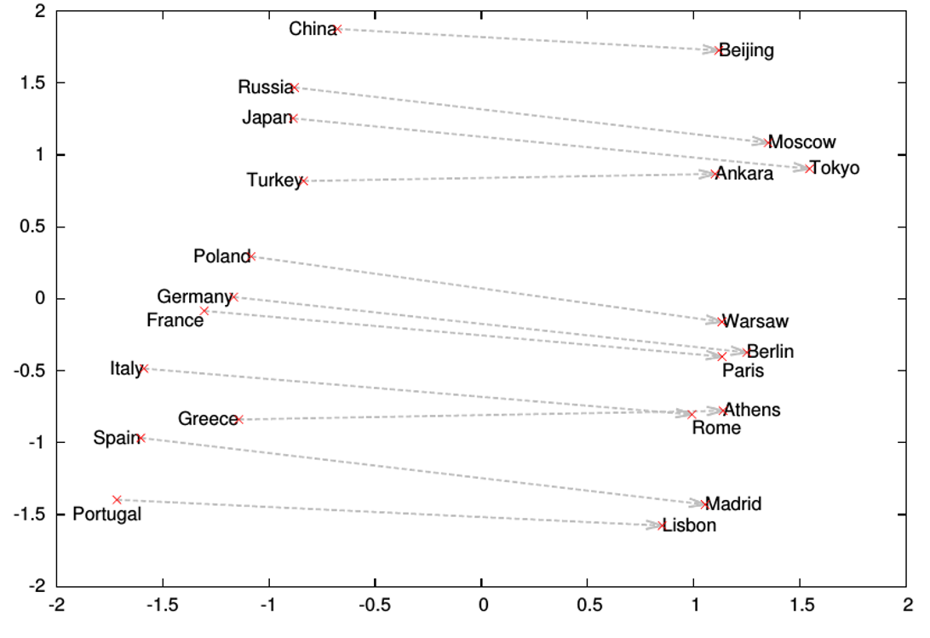
Word analogies
www.cs.ucr.edu/~vagelis/classes/CS242/slides/word2vec.pptx

Slide 28
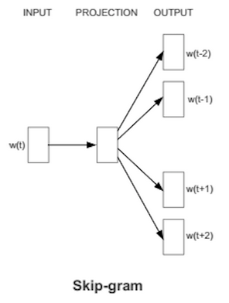
Skip gram
Skip gram – alternative to CBOW
Start with a single word embedding and try to predict the surrounding words.
Much less well-defined problem, but works better in practice (scales better).

Slide 29
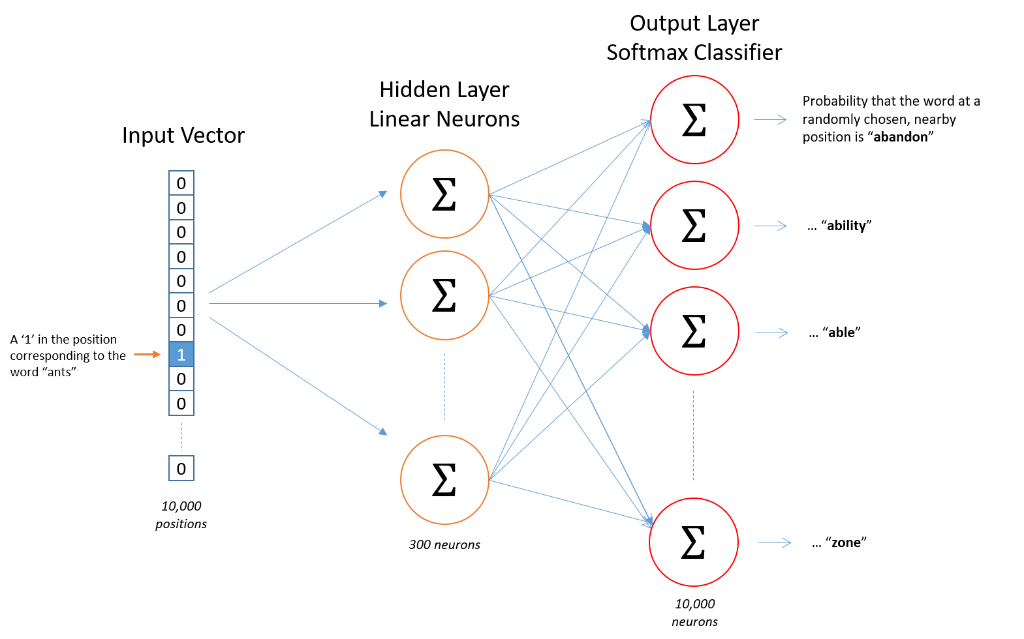
Skip gram
Map from center word to probability on surrounding words. One input/output unit below.
There is no activation function on the hidden layer neurons, but the output neurons use softmax.
http://mccormickml.com/2016/04/19/word2vec-tutorial-the-skip-gram-model/

Slide 30
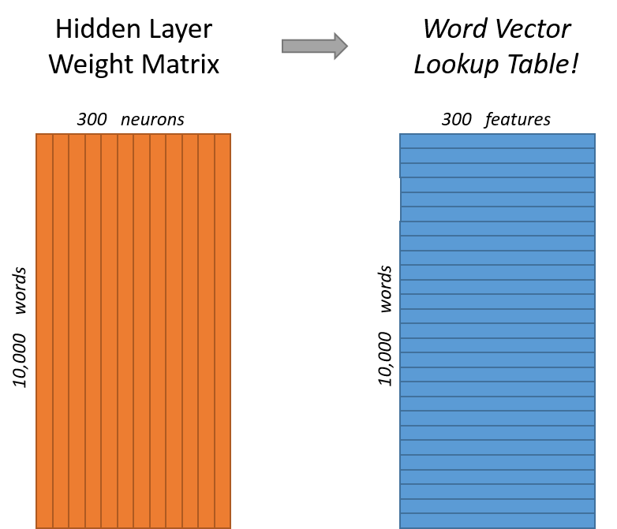
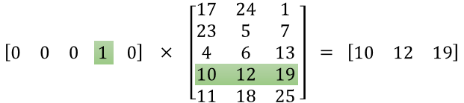
Skip gram example
Vocabulary of 10,000 words.
Embedding vectors with 300 features.
So the hidden layer is going to be represented by a weight matrix with 10,000 rows (multiply by vector on the left).
http://mccormickml.com/2016/04/19/word2vec-tutorial-the-skip-gram-model/

Slide 31
Skip gram/CBOW intuition
Similar “contexts” (that is, what words are likely to appear around them), lead to similar embeddings for two words.
One way for the network to output similar context predictions for these two words is if the word vectors are similar. So, if two words have similar contexts, then the network is motivated to learn similar word vectors for these two words!
http://mccormickml.com/2016/04/19/word2vec-tutorial-the-skip-gram-model/

Slide 32
Word2vec shortcomings
Problem: 10,000 words and 300 dim embedding gives a large parameter space to learn. And 10K words is minimal for real applications.
Slow to train, and need lots of data, particularly to learn uncommon words.
Notes:
🔹 Word2Vec Shortcomings
Large parameter space
Suppose we have a vocabulary of 10,000 words and each word is represented by a 300-dimensional vector.
That means we need a matrix with 10,000 × 300 = 3 million parameters to learn.
More words = even bigger matrix = harder and slower to train.
Training is slow and data-hungry
Word2Vec learns from context, so it needs lots of text data.
Common words (like the, is, of) dominate training, while rare words (like photosynthesis or quasar) don’t get enough examples to learn good vectors.

Slide 33
Word2vec improvements: word pairs and phrases
Idea: Treat common word pairs or phrases as single “words.”
E.g., Boston Globe (newspaper) is different from Boston and Globe separately. Embed Boston Globe as a single word/phrase.
Method: make phrases out of words which occur together often relative to the number of individual occurrences. Prefer phrases made of infrequent words in order to avoid making phrases out of common words like “and the” or “this is”.
Pros/cons: Increases vocabulary size but decreases training expense.
Results: Led to 3 million “words” trained on 100 billion words from a Google News dataset.

Slide 34
Word2vec improvements: subsample frequent words
Idea: Subsample frequent words to decrease the number of training examples.
The probability that we cut the word is related to the word’s frequency. More common words are cut more.
Uncommon words (anything < 0.26% of total words) are kept
E.g., remove some occurrences of “the.”
Method: For each word, cut the word with probability related to the word’s frequency.
Benefits: If we have a window size of 10, and we remove a specific instance of “the” from our text:
As we train on the remaining words, “the” will not appear in any of their context windows.
Notes:
✅ Subsampling frequent words
Drop very common words (like the, and) sometimes.
Keeps rare words.
Makes training faster & context windows more meaningful.

Slide 35
Word2vec improvements: selective updates
Idea: Use “Negative Sampling”, which causes each training sample to update only a small percentage of the model’s weights.
Observation: A “correct output” of the network is a one-hot vector. That is, one neuron should output a 1, and all of the other thousands of output neurons to output a 0.
Method: With negative sampling, randomly select just a small number of “negative” words (let’s say 5) to update the weights for. (In this context, a “negative” word is one for which we want the network to output a 0 for). We will also still update the weights for our “positive” word.
Notes:
✅ Selective updates (Negative Sampling)
Instead of updating all weights, update only a few (positive + small set of random negatives).
Much faster training.
Still learns good word vectors.

Slide 36
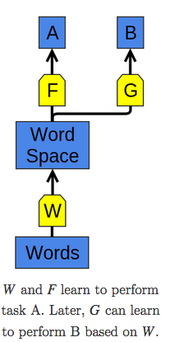
Word embedding applications
The use of word representations… has become a key “secret sauce” for the success of many NLP systems in recent years, across tasks including named entity recognition, part-of-speech tagging, parsing, and semantic role labeling. (Luong et al. (2013))
Learning a good representation on a task A and then using it on a task B is one of the major tricks in the Deep Learning toolbox.
Pretraining, transfer learning, and multi-task learning.
Can allow the representation to learn from more than one kind of data.
http://colah.github.io/posts/2014-07-NLP-RNNs-Representations/

Slide 37
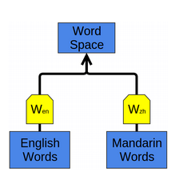
Word embedding applications
Can learn to map multiple kinds of data into a single representation.
E.g., bilingual English and Mandarin Chinese word-embedding as in Socher et al. (2013a).
Embed as above, but words that are known as close translations should be close together.
Words we didn’t know were translations end up close together!
Structures of two languages get pulled into alignment.
http://colah.github.io/posts/2014-07-NLP-RNNs-Representations/

Slide 38
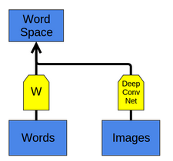
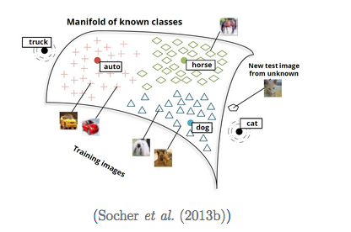
Word embedding applications
Can apply to get a joint embedding of words and images or other multi-modal data sets.
New classes map near similar existing classes: e.g., if ‘cat’ is unknown, cat images map near dog.
http://colah.github.io/posts/2014-07-NLP-RNNs-Representations/

